Slide 1
BOJJA SRIKAR
Identification & Optical character recognition (OCR) for Structured Documents
15-05-2022

Slide 2
Problem Statement
Why did you decide to solve this Problem statement?
Generally , Now a days every information present in papers or documents are digitalized .
In normal process of digitilization people use man power to convert physical data into digital data and they store the data In txt files manually by typing .
But now in 21th centuray era , man thinks smart, people are feed up with manual work power, so we can extract the information from the documents or written papers with out a human interface using Identification & Optical character recognition (OCR) .
So, to achieve the following smart era objectives I came up with following idea of Identification & Optical character recognition (OCR) for Structured Documents

Slide 3
User Segment & Pain Points
Which user /advertiser segment would be early adopter of your product & why?
Each and every company(MNCs)
BANKS
JOB providers
HRs
Parlament
Collector office (govt)
every orginazation which contains paper work or documentation work will be the ed users of the following product.

Slide 4
Pre-Requisite
What are the alternatives/competitive products for the problem you are solving?
Adobe Acrobat Pro DC. The best for scanning documents.
OmniPage Ultimate. OCR scanning for professionals.
Abbyy FineReader
Readiris
Rossum.

Slide 5
Any Supporting Functional Documents
Present your solution, talk about methodology, architecture & scalability
Currently I am doing OCR using Matlab.
Here , in matlab we have vaste amount of feature extraction techiniques which can be used for the prototype development .
The OCR is a Computer vision toolbox function in the matlab.
In the Next Slide the Archituture is Shown , for OCR along OCR we use Face detection to find the pictures in the document of resume , aadhar etc..

Slide 6
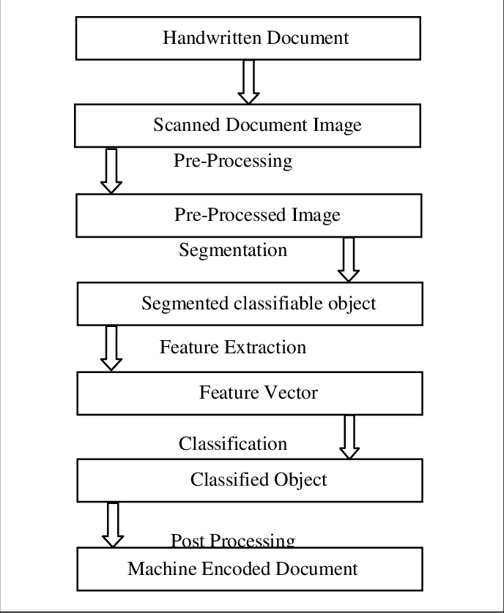
Architecture

Slide 7
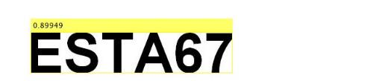
Key Differentiators & Adoption Plan
How is your solution better than alternatives and how do you plan to build adoption?
In the all other solutions in the market they are not using face detection techinques and the accuracy of the other models is low.
We are showing the accurecy of detection of the word called confidence of the each word detected.
Here for example the 0.899949 is the confidence of the image detected correctly and converted in to text.

Slide 8
GitHub Repository Link & Demo Video/ Screenshot
How far it can go?
We can make this product a global market .
Like adobe we can make its avaialblity globally.
https://github.com/theboss21101999/OCR-using-matlab.git

Slide 9
Thank You
BOJJA SRIKAR

